Slide 1
Input, process, output.

Slide 2
Learning objectives
All
Understand the importance of input, process, output
Describe an example of IPO
Identify the Scratch tools needed
Most
Apply IPO techniques in Scratch quiz
Some
Evaluate the effectiveness of a solution

Slide 3
Outcomes
All
Describe I,P,O in some example scenarios
Most
Create Scratch quiz which uses I,P,O
Update programming log with some annotation
Some
Write a brief written evaluation of solution

Slide 4
Create your ‘programming log’ document.
To record the evidence of the code you produce and the skills you learn each lesson, we will be create google docs file to keep track.
Here is an example….

Slide 5
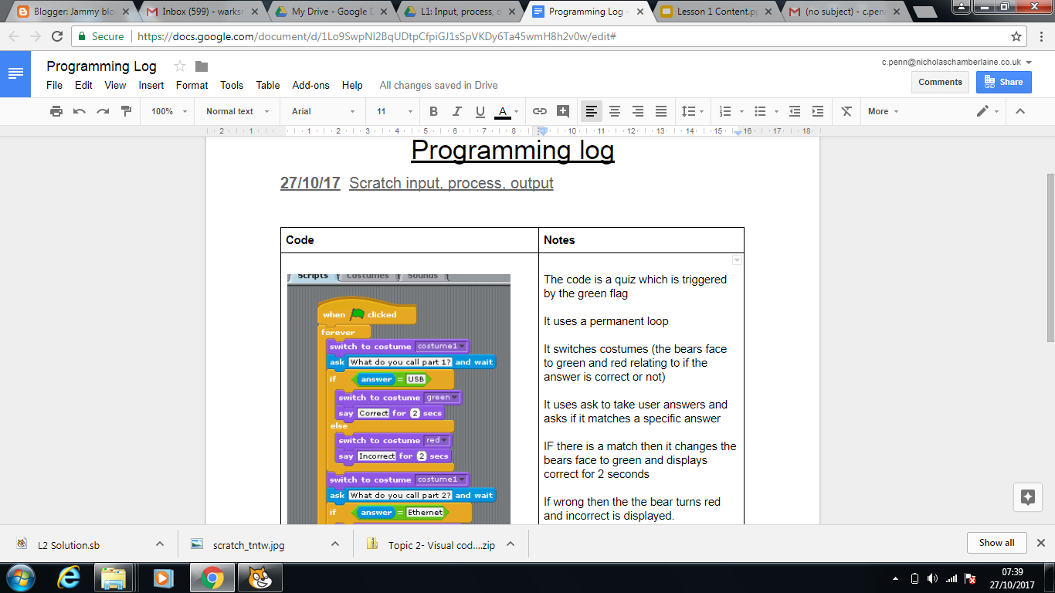
Programming log example...
link

Slide 6
Now it is your turn.

